Slide 1
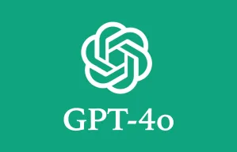
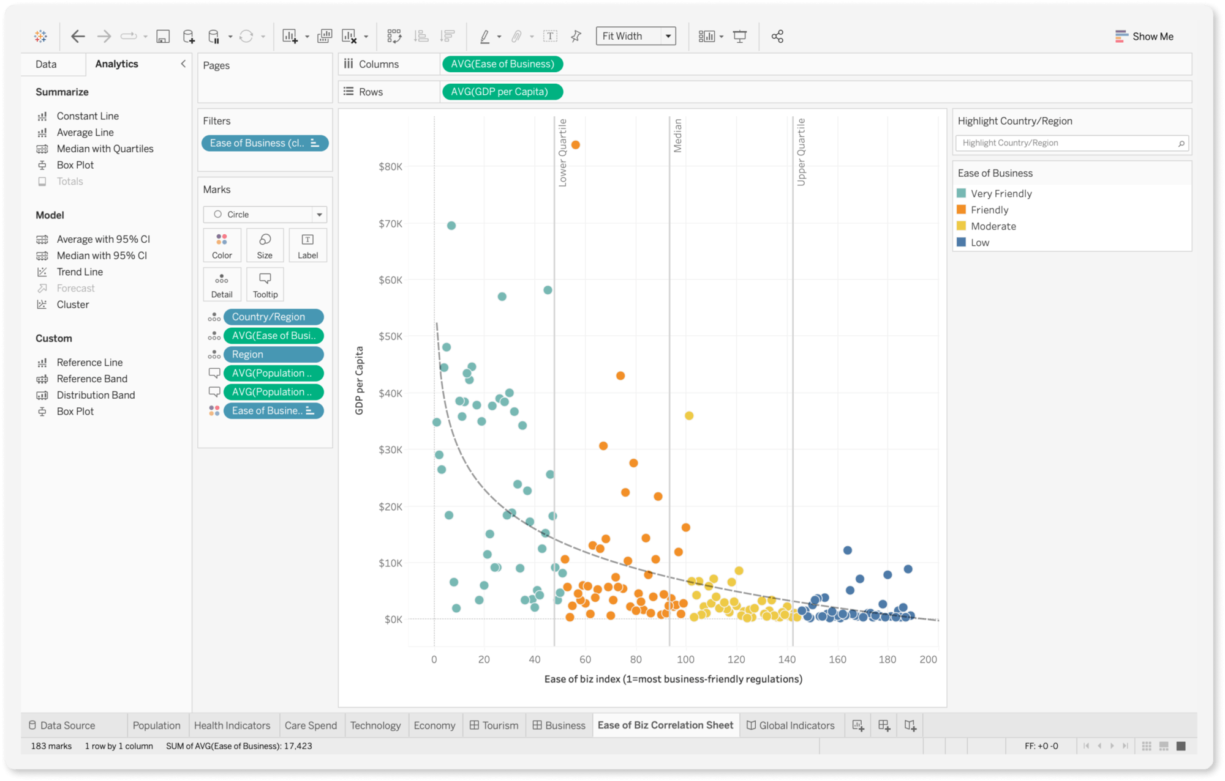
Creating a Custom Data Analysis Tool with LLMs - Easy Step-by-Step Guide
Data Science Lab | Your Guide to Data Science Mastery

Slide 2
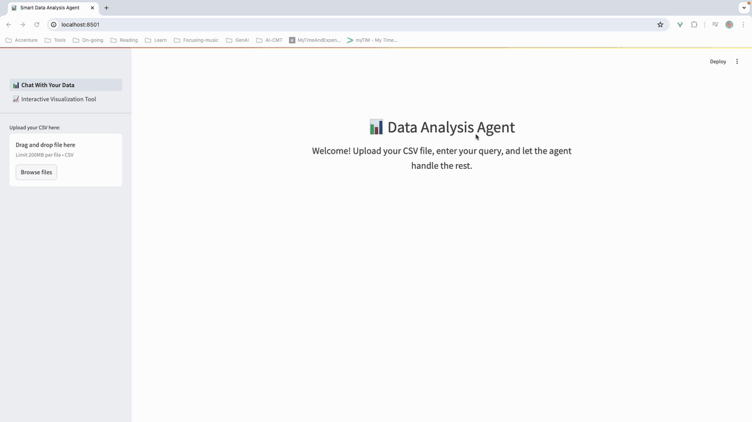
Introduction to DAGPT - Demo

Slide 3
Introduction to DAGPT - Overview
DAGPT: Data Analysis GPT is a helpful data analysis tool that uses LLMs to assist with data manipulation and analysis tasks via a conversational interface.
Using Streamlit to provide an interactive web application where users can upload their data, ask questions, explore your data interactively and receive insights.
Alternative tool for Chat GPT-4o and Tableau and suitable for any data analysis tasks in your local machine.

Slide 4
Introduction to DAGPT - Features (1/3)
CSV File Upload: Easily upload your CSV data through the sidebar.
Data Analysis: Enter queries about your data and get responses powered by LLMs.
Data Visualization: Generate and display plots based on your data queries.
Interactive Visualization Tool: Explore your data interactively using various visualizations. Upload your dataset and start analyzing with drag-and-drop functionality to create customized charts.

Slide 5
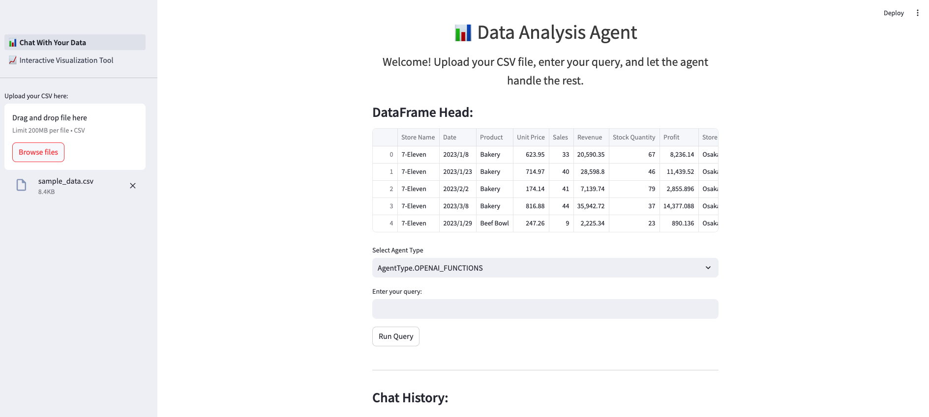
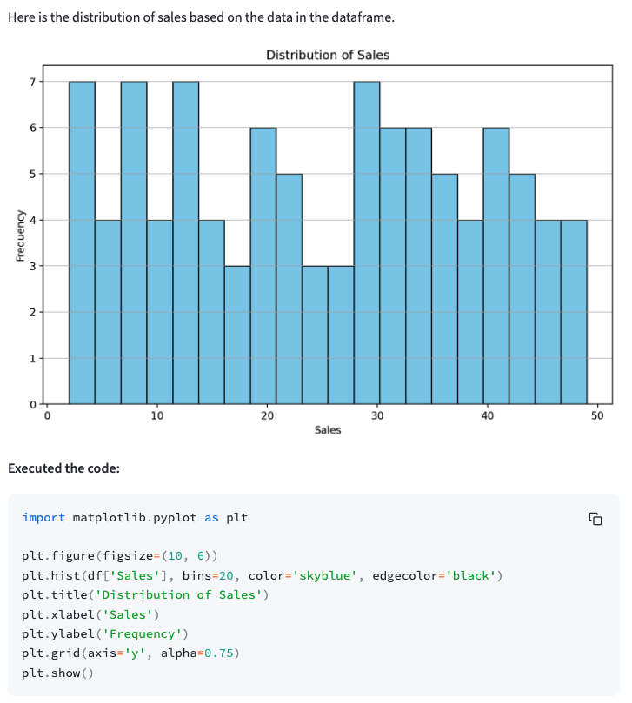
Introduction to DAGPT - Features (2/3)
CSV File Upload: Easily upload your CSV data through the sidebar.
plot sale distribution
Data Analysis: Enter queries about your data and get responses powered by LLMs.
Data Visualization: Generate and display plots based on your data queries.

Slide 6
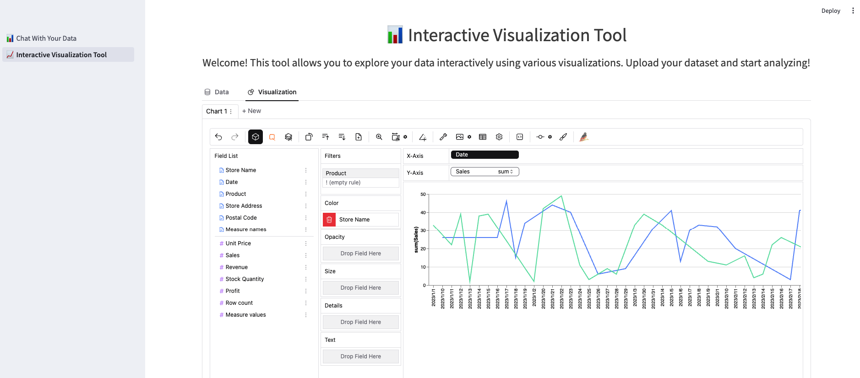
Introduction to DAGPT - Features (3/3)
Interactive Visualization Tool: Explore your data interactively using various visualizations. Upload csv data and start analyzing with drag-and-drop functionality to create customized charts.

Slide 7
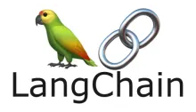
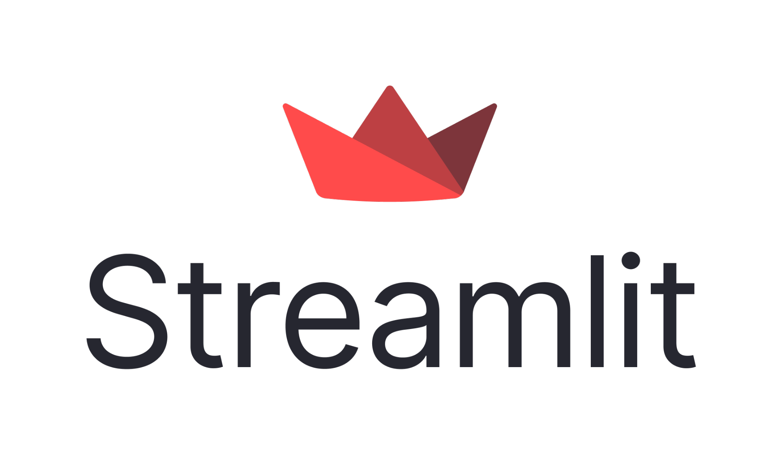

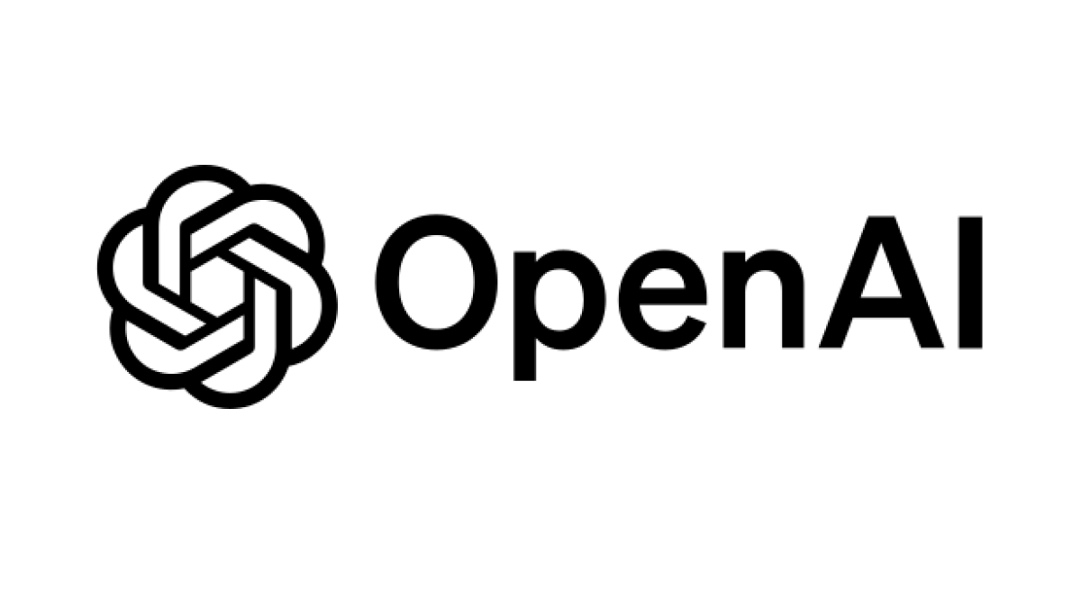
2. Tools and Packages Needed to Build This App
Python 3.9 or Higher:
The primary programming language used for developing the app.
Langchain:
A framework for developing applications powered by language models. It provides tools to connect language models with other data sources, manage interactions, and create advanced AI applications.
Streamlit:
An open-source app framework for Machine Learning and Data Science projects. It allows you to create interactive web apps with Python.
Pygwalker:
A tool for creating interactive visualizations.
OpenAI API (optional):
Used to access advanced language models for enhanced capabilities.

Slide 8
3. Tutorial - Steps
Step 1
Step 2
Step 3
Basic setup
・Build a project structure
・Setup virtual environment
・Install necessary packages
・Setup git reporitoty to store our project code
Build “Chat With Your Data” Tool
・Use streamlit to build our UI interface
・Use agent toolkits provided by langchain to build our data analysis agent
・Use OpenAI GPT model
Build “Interactive Visualization” Tool
・Embed pygwalker into our streamlit interface to build our interactive visualization tool
Link to github: https://github.com/datasciencelab-ai/dagpt

Slide 9
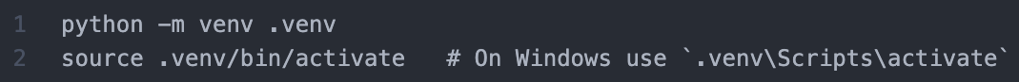
3. Tutorial - Basic setup
Project structure:
Using “Cookiecutter Data Science” to build a logical standardized project structure
Setup virtual environment:
Install necessary packages: pip install -r requirements.txt
# requirements.txt
langchain==0.2.6
langchain-community==0.2.6
langchain-openai==0.1.13
streamlit==1.36.0
pygwalker==0.4.9.1
pandas==1.5.3
matplotlib==3.9.0

Slide 10
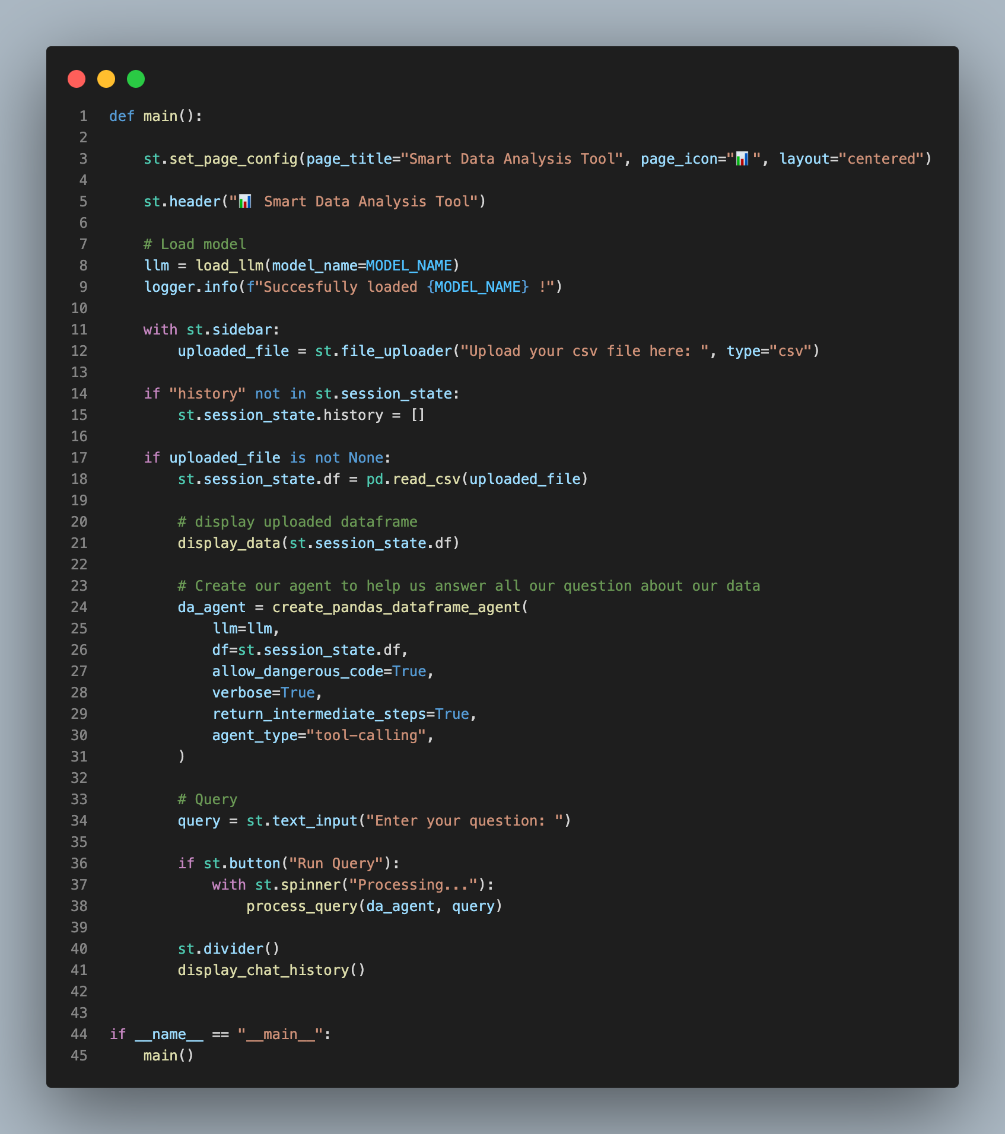
3. Tutorial - Live coding

Slide 11
4. Conclusion
With the capability of LLMs, it is very easy to write an app that do a daily complex data analysis tasks.
Using Streamlit help to easily build a conversational interface and powerful visualization capabilities, it makes data analysis accessible to all.
Pygwalker is a free and useful tools alternative to Tableau and can be embedded in our own app
By following this guide, everyone can build your own data analysis tool leveraging the power of LLMs and Streamlit

Slide 12
Appendix

Slide 13
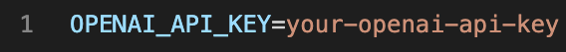
How to setup OpenAI API key
Sign Up / Log In to OpenAI:
Visit the OpenAI website and create an account or log in if you already have one.
Navigate to API Keys:
Once logged in, go to the API section in your account dashboard. This is typically found under the "API Keys" tab.
Create a New API Key:
Click on the "Create new secret key" button. This will generate a new API key for you to use.
Copy the API Key:
After the key is generated, make sure to copy it and replace your API key in the `.env` file in your project.

Slide 14

Introduction to DAGPT - Demo

